Slide 1


Heart Disease Prediction
Vikas Ranjan
DSC680, Summer 2021
Bellevue University, NE

Slide 2
Problem Statement
According to WHO, an estimated 17.9 million people died from heart diseases in 2019, representing 32% of all global deaths.
This project is focused on building a model to predict if a person will get heart disease in 10 years.
Fetch and analyze key insights from the risk factors in the data set.
Such insights and predictions are going to help with early prognosis of heart diseases can help in making decisions on lifestyle changes in high-risk patients and in turn reduce the complications, fatalities, and overall healthcare cost on economy.

Slide 3
Process Overview
Preliminary analysis on data
Data preparation and cleaning for any missing values
Perform Exploratory Data Analysis
Train and test models
Model evaluation and tuning

Slide 4

Dataset Details
Dataset contains demographic, behavioral, and medical risk factors.
This dataset includes 4238 rows and 15 feature variables.
Identified and removed the outliers from the dataset.
Performed scaling of data using StandardScaler

Slide 5
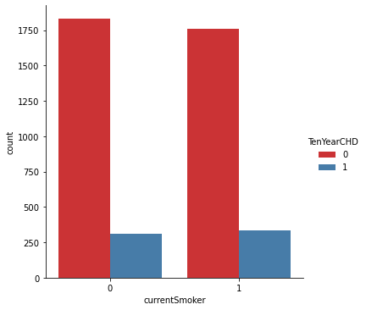
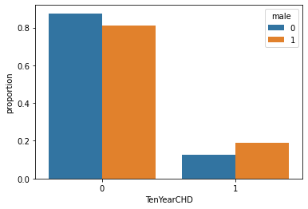
Exploratory Data Analysis

Slide 6
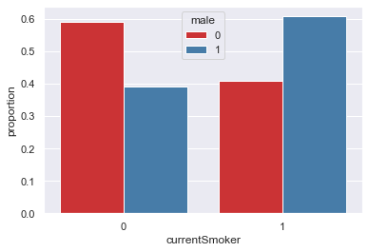
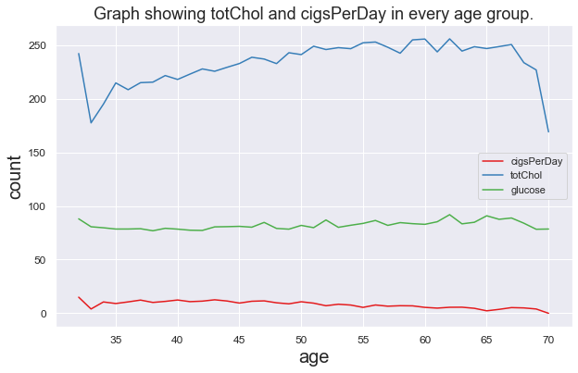
Exploratory Data Analysis

Slide 7
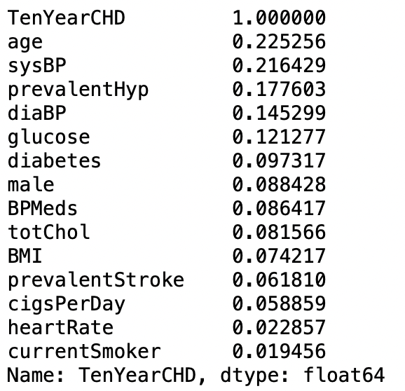
Correlations
The strongest positive correlations of TenYearCHD are with age and sysBP.
CurrentSmoker has the least correlation with TenYearCHD.

Slide 8
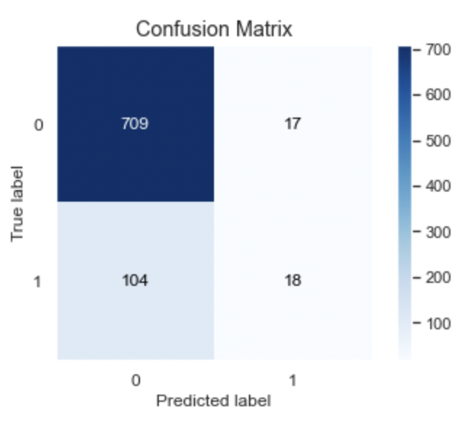
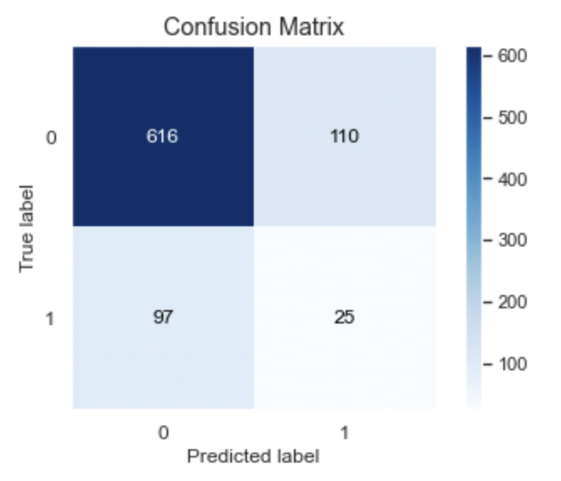
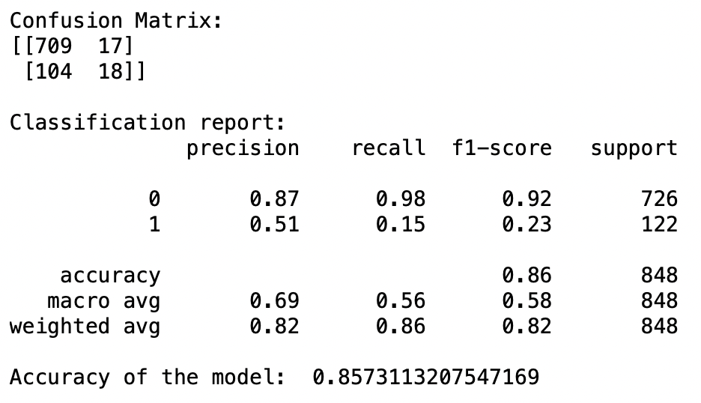
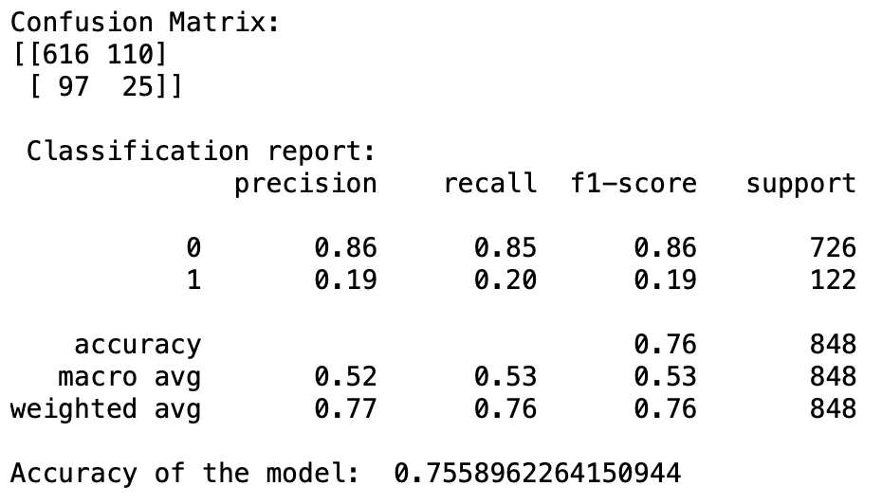
Models
Random Forest
Logistic Regression

Slide 9
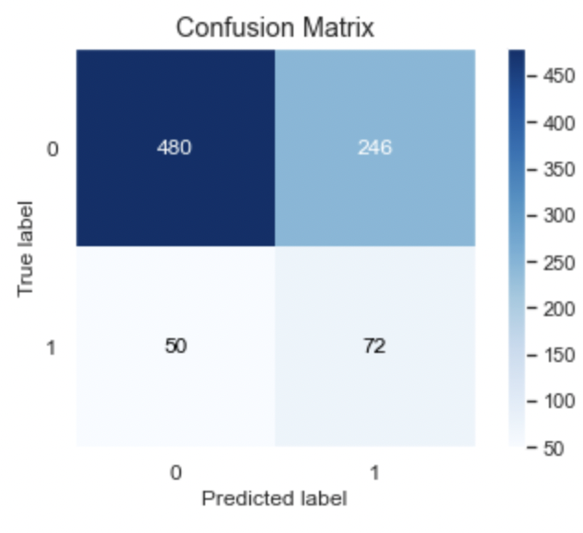
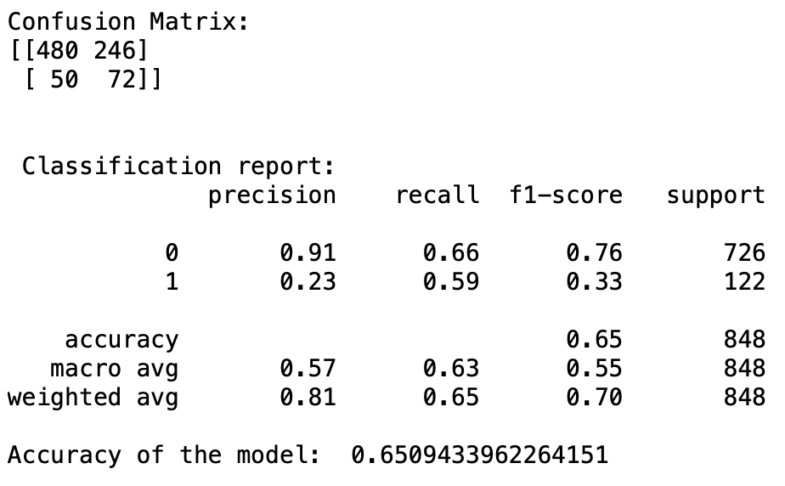
Models
KNN Classification
Decision Tree Classification

Slide 10
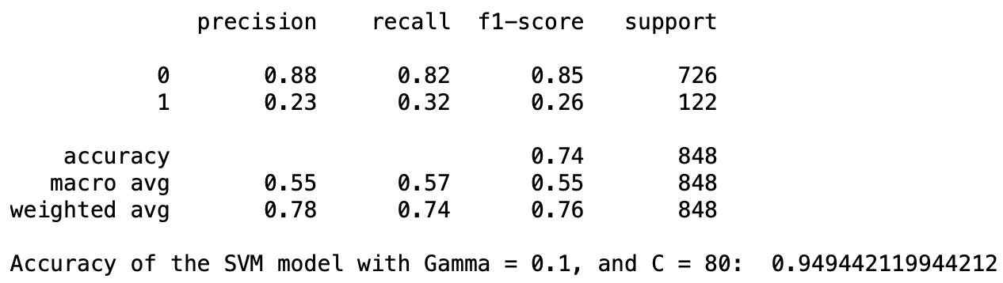
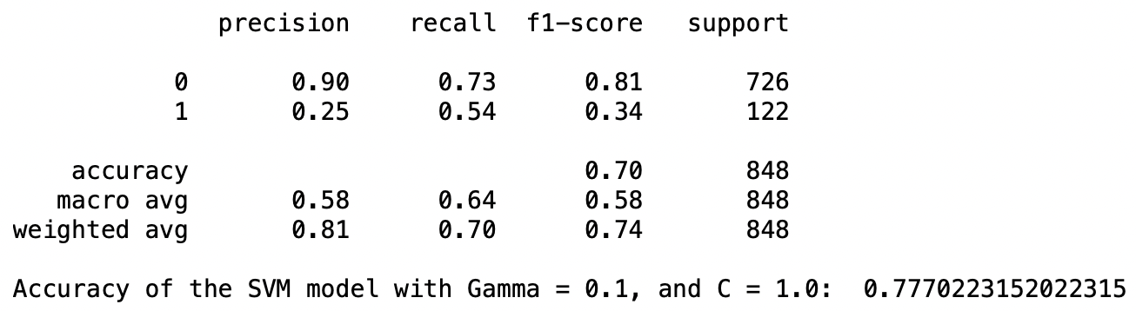
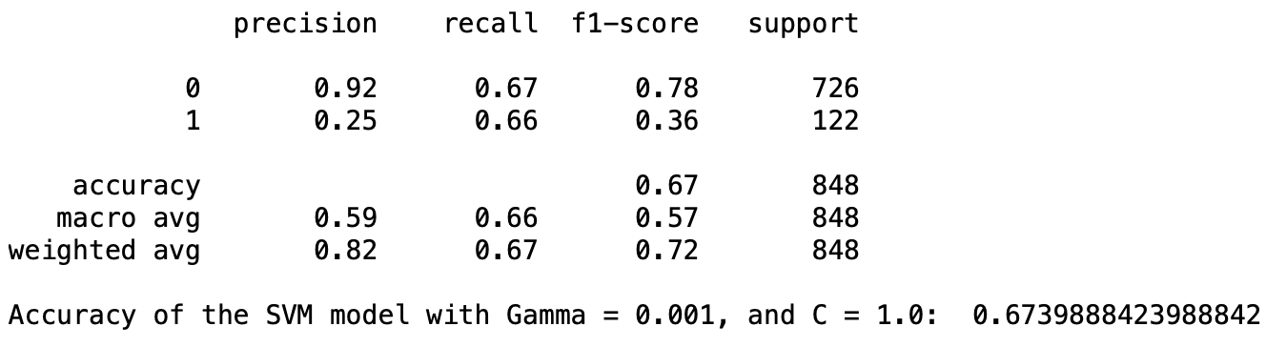
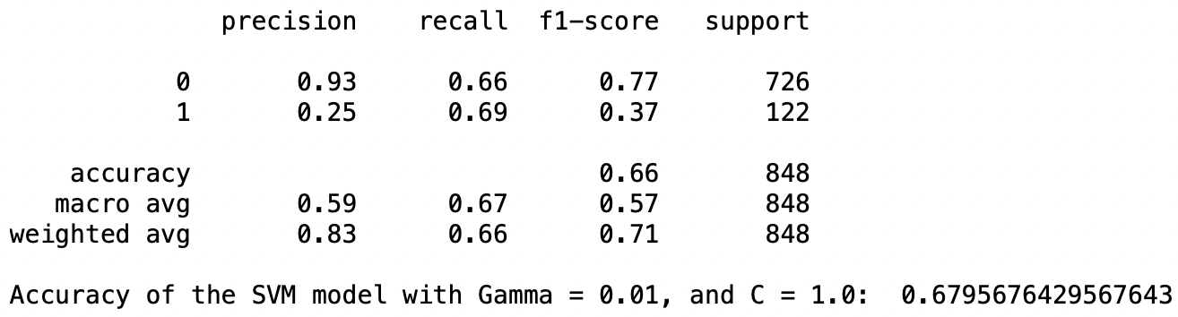
Models
SVM Classification Models

Slide 11
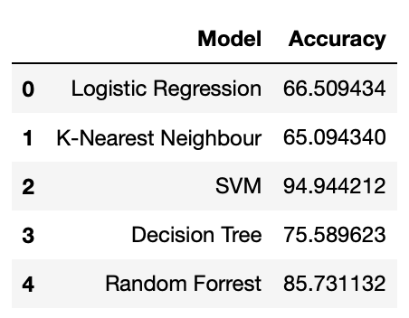
Models Evaluations
Comparison of the implemented models in terms of accuracy.
Among the 5 classification models, SVM classification model had the best accuracy score, followed by Random Forest classification model.

Slide 12
Conclusions
The strongest positive correlations of TenYearCHD are with age and sysBP.
Performed Standardization technique to scale the data before running it through the ML algorithms.
Since the training dataset was moderately imbalanced, applied Random oversampling technique to overcome the imbalanced datasets challenge.
Based on the accuracy of the implemented classification models to predict TenYearCHD, SVM classification model shows highest accuracy followed by Random Forest classification model.

Slide 13
References
Dileep. (2019, June 7). Logistic regression to predict heart disease. Kaggle. https://www.kaggle.com/dileep070/heart-disease-prediction-using-logistic-regression.
Mathur, P., Srivastava, S., Xu, X., &amp; Mehta, J. L. (2020, September 9). Artificial intelligence, machine learning, and cardiovascular disease. Clinical Medicine Insights. Cardiology. https://www.ncbi.nlm.nih.gov/pmc/articles/PMC7485162/.
Shah, D., Patel, S., &amp; Bharti, S. K. (2020, October 16). Heart disease prediction using machine learning techniques. SN Computer Science. https://link.springer.com/article/10.1007/s42979-020-00365-y.
HealthITAnalytics. (2020, August 5). Artificial intelligence may accelerate heart failure diagnosis. HealthITAnalytics. https://healthitanalytics.com/news/artificial-intelligence-may-accelerate-heart-failure-diagnosis.
Applied Text Analysis with Python, Benjamin Bengfort, Rebecca Bilbro & Tony Ojeda
Machine Learning with Python Cookbook, Chris Albon

